Slide 1
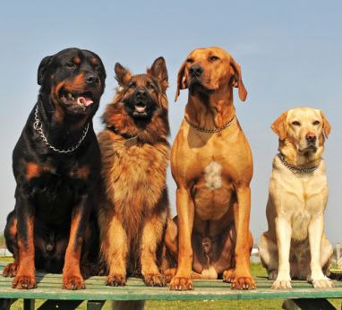
T09 - Hub Dawgs
Sam Bonafe, Cameron Connell, Tri Nguyen, and Evan Williams

Slide 2
Progress
Created and filled out the Kanban board
Completed user stories
Finished CRC cards and the UML
Found a meeting time that works for everyone (possibly our first epic)

Slide 3
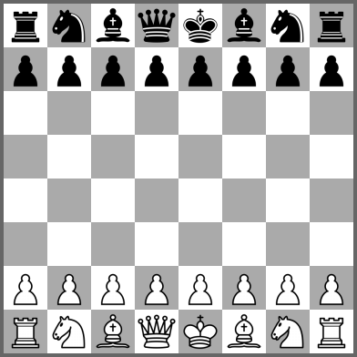
Extinction Game
Extinction chess:
Simple
Normal Pieces
Many Win Conditions
Pawns can become a king

Slide 4
Process/product decisions made
Added a database
Kanban with Review
4 CRC cards
Refactored these into 8 Primary classes and 6 subclasses for pieces in our UML Diagram

Slide 5
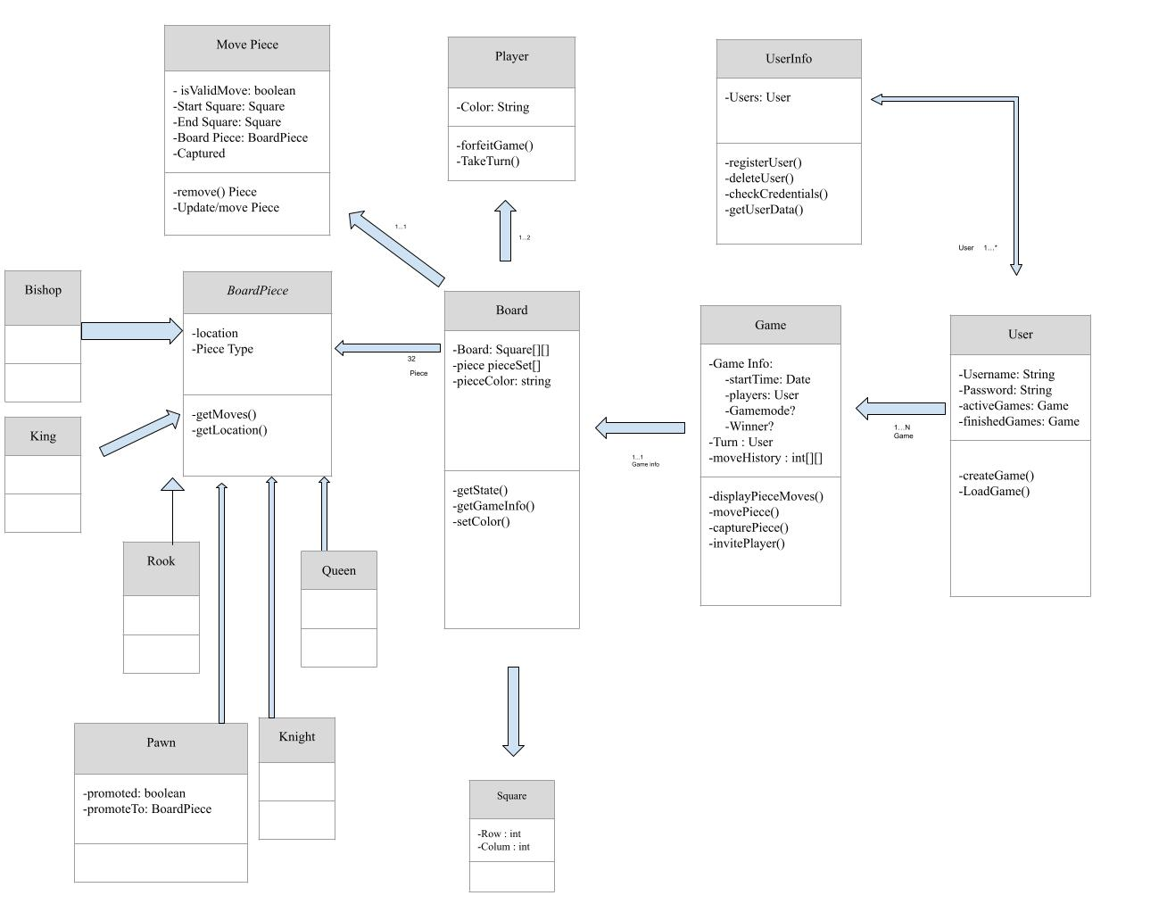

Slide 6
Scrum ceremonies
Schedule
6 Sprints with 2 week durations
Things that went well
Active communication & team chemistry
Cohesiveness to complete work together
Things that we need to improve
Regular meeting times
Team member left - redistributing work
One thing we will change next time
One in-person scrum a week

